Slide 1


SOLID Principles
Assignment.
Name - Tushar Dhiman
Emp ID - 1855
Notes:
Note: First “Right Click” on the Gradient background, go to “Order” option and “Send it to Back”, then insert your picture into “Image Placeholder”, “Right Click” on the picture and again go to “Order” option and “Send it to Back” to get the “Gradient” effect.

Slide 2
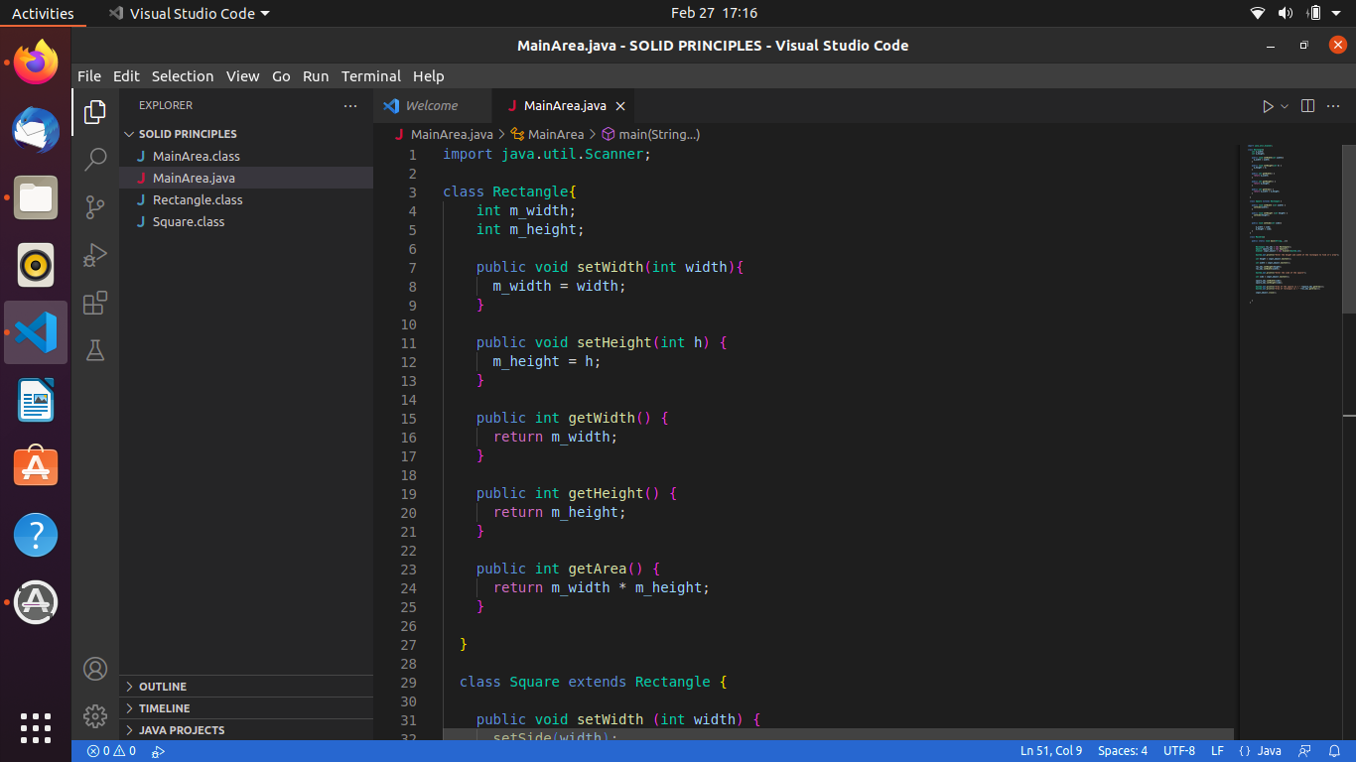
Source Code

Slide 3
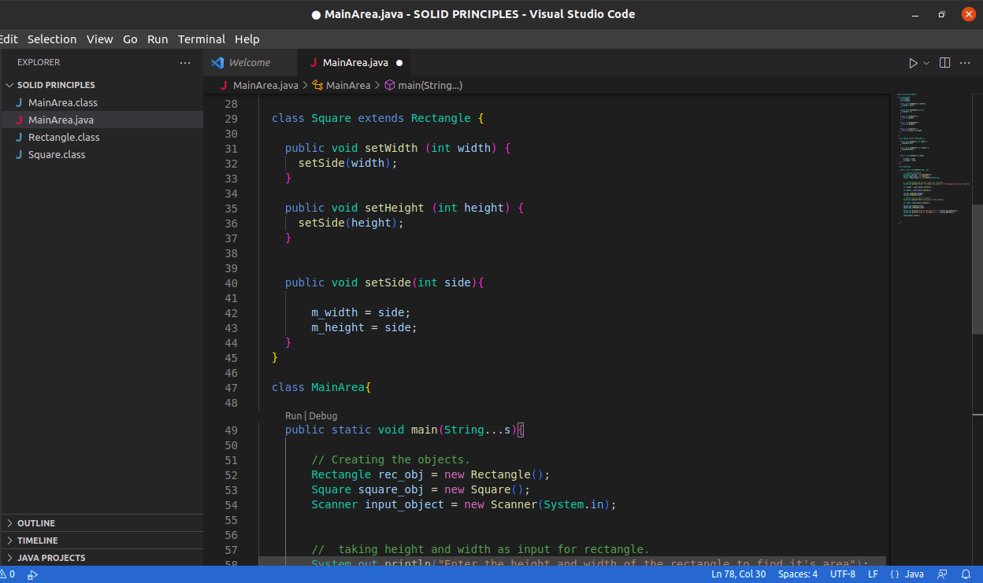
Source Code

Slide 4
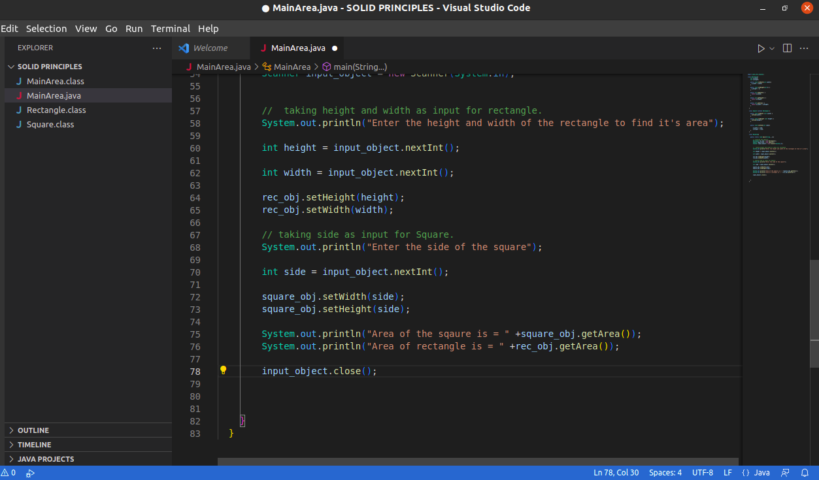
Source Code

Slide 5
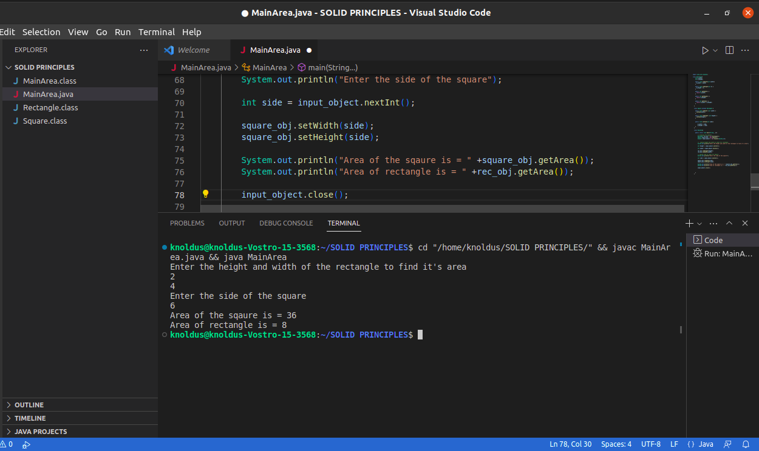
Output

Slide 6
Thank you

